Slide 1


Slide 7
Slide 6
Welcome to Our Today’s Presentation
Customizable Portfolio
Slide 5
Slide 4
Slide 3
"Craft your story, showcase your brilliance a customizable portfolio, your tailored narrative canvas."
Slide 2
Under the guidance of,
Prof. Arpita, Asst. Prof,Dept. of CSE,PES University respective theory class faculty
Slide 1

Slide 2






Slide 7
Functionalities
"Unlock Your Potential, Showcase Your Journey! Craft an Interactive Portfolio
Tailored for Students and Freelancers, Elevating Your Skills and Projects."
Slide 6
Dynamic Portfolio showcase
Secure Admin Access
Slide 5
Display your work elegantly with a customizable portfolio, managing projects, certifications, and personal details efficiently through a user-friendly interface.
Ensure secure admin access for portfolio management, granting exclusive control over content updates and modifications for an organized and tailored presentation
Slide 4
Effortless image handling
Database-Driven Design
Simplify image management by enabling image uploads, updates, and deletions, ensuring a smooth process to showcase your visual content.
Utilize SQL Alchemy to manage database operations, allowing seamless storage, retrieval, and modification of portfolio items, ensuring efficient data handling.
Slide 3
Social Media Integration:
Slide 2
Interactive Contact form
Engage visitors effectively with an interactive contact form, allowing seamless communication, collecting inquiries, and facilitating hassle-free interactions.
Seamlessly integrate social media links within the portfolio, providing visitors with direct access to social profiles, enhancing connectivity, and networking possibilities.
Slide 1

Slide 3






Slide 7
Functionalities
Slide 6
Interactive Multimedia Integration
User Engagement
Incorporate images, videos, and documents to showcase work dynamically and vividly.
Facilitate interactions with visitors through comment sections, contact forms, and social media integration.
Slide 5
Slide 4
Project Management
Accessibility and Responsiveness:
Organize and highlight projects with diverse filters and categories for easy navigation and exploration.
Ensure seamless user experience across devices, making it accessible and visually appealing to a wide audience.
Slide 3
Skill Emphasis
Customizable Showcase
Slide 2
Showcase skills through detailed descriptions, testimonials, and linked projects for validation
Create a personalized space to display projects, skills, achievements, and experiences.
Slide 1

Slide 4
Modules Used
Slide 7
"Transforming portfolios into immersive experiences, empowering your professional story."
Slide 6
1.Flask-related modules
Flask==2.3.2
Flask_Bcrypt==1.0.1
Flask_Login==0.6.2
Flask_MySQLdb==1.0.1
Flask_SQLAlchemy==3.0.3
Flask_Uploads==0.2.1
Flask_WTF==1.1.1
LoginManager
abort
Blueprint
jsonify
login_required
UserMixin
2.Jinja,MarkupSafe
MarkupSafe==2.1.2
Jinja2==3.1.2
3.Database-related modules
PyMySQL==1.0.3
SQLAlchemy==2.0.15
mysql_connector==2.2.9
mysql_connector_python==8.0.33
mysqlclient==2.1.1
create_engine
declarative_base
Column
relationship
ColumnDefault
4.Cryptography and Security modules
bcrypt==4.0.1
cryptography==41.0.0
dnspython==2.3.0
email_validator==2.0.0.post
its dangerous==2.1.2
generate_password_hash
check_password_hash
WTF_CSRF_SECRET_KEY
Slide 5
Slide 4
Slide 3
Slide 2
Slide 1

Slide 5
Modules Used
Slide 7
“Transform your academic journey into a visually engaging narrative, showcasing your talents and aspirations, propelling you towards future success as industry pioneers."
Slide 6
5.Other utility modules:
click==8.1.3
greenlet==2.0.2
idna==3.4
protobuf==3.20.3
pycparser==2.21
typing_extensions==4.6.2
wheel==0.41.3
setuptools==68.2.2
pip==23.3.1
6.Activators:
BashActivator
BatchActivator
FishActivator
NushellActivator
PowerShellActivator
PythonActivato
7.Python modules:
os
datetime
werkzeug.utils.secure_filename
werkzeug.datastructures.FileStorage
8.Flask extensions:
flask_sqlalchemy
flask_wtf
flask_uploads
Slide 5
Slide 4
Slide 3
Slide 2
Slide 1

Slide 6
Timeline Slide
Slide 7
"Empower Your Story: Craft, Share, and Shine with Your Dynamic Portfolio - Elevate Your Journey!"
Slide 6
Interactive User Interface
File Upload and Management
Real-time Updates/Database Interaction
Slide 5
Learning and Future Work
Slide 4
Algorithms
Slide 3
Live Demo
Slide 2
Flask Routing and Model Creation
File Handling and Database Operations
Template Rendering and Dynamic Content
Learning from the Project
Adaptability and Versatility
Slide 1

Slide 7
.
Algorithms
Algo 2
Slide 1
Algo 4
Algo 5
Home Page
Base template
1. Define route '/' for the home page.
2. Fetch data from index_phara, socials, cIndex_name, cIndex_img_self, cIndex_img_big, and certdb tables.
3. Render 'cIndex.html' template.
- Pass fetched data to the template for display
1. Define route '/base' for displaying a base page.
2. Fetch data from socials and cIndex_name tables.
3. Render 'base.html' template.
- Pass fetched data to the template for display.
Self profile
Banner URL
1. Define route '/self' for handling image uploads.
2. If the method is POST:
- Extract uploaded image and details from the form.
- Store the image in the cIndex_img_self table in the database.
3. Fetch data from cIndex_img_self, socials, and cIndex_name tables.
4. Render 'self.html' template.
- Pass fetched data to the template for display.
1. Define route '/big' for handling larger image uploads.
2. If the method is POST:
- Extract uploaded larger image and details from the form.
- Store the image in the cIndex_img_big table in the database.
3. Fetch data from cIndex_img_big, socials, and cIndex_name tables.
4. Render 'big.html' template.
- Pass fetched data to the template for display.

Slide 8
Algorithms
Slide 7
algo 4
Slide 2
algo 3
Get image
Deleting image
Slide 6
1. Define route '/self/<int:id>' to fetch and display a specific image from cIndex_img_self by ID.
2. Retrieve the image data by ID from cIndex_img_self table in the database.
3. Return the image as a Response with appropriate mimetype.
1. Define route '/selfDel/<int:id>' to delete a specific image from cIndex_img_self by ID.
2. Find the image entry by ID from cIndex_img_self table and delete it.
3. Redirect to '/self' route.
Slide 5
Slide 4
Edit / Update
Project URL
1. Define route '/editSelf' for updating the details of the self-image.
2. If the method is POST:
- Extract updated details from the form for the self-image.
- Update the details in the cIndex_img_self table in the database.
3. Redirect to '/self' route.
1. Define route '/project' for handling projects' data.
2. Fetch data from project dB table in the database.
3. Render 'project.html' template.
- Pass fetched data to the template for display.

Slide 9
Algorithms
Slide 7
algo 4
algo 3
algo 2
Certifications
Editing base
Slide 6
1. Define route '/cert' for handling certifications' data.
2. Fetch data from certdb table in the database.
3. Render 'cert.html' template.
- Pass fetched data to the template for display.
1. Define route '/editBase' for updating the details of the base page.
2. If the method is POST:
- Extract updated details from the form for the base page.
- Update the details in the cIndex_name and socials tables in the database.
3. Redirect to '/base' route.
Slide 5
Slide 4
Edit banner
Edit project
1. Define route '/editBig' for updating the details of the larger image.
2. If the method is POST:
- Extract updated details from the form for the larger image.
- Update the details in the cIndex_img_big table in the database.
3. Redirect to '/big' route.
1. Define route '/editProject' for updating project details.
2. If the method is POST:
- Extract updated project details from the form.
- Update the details in the projectdb table in the database.
3. Redirect to '/project' route.

Slide 10
Algorithm for Admin page
Slide 7
algo 3
algo 4
algo 2
Step 1: Route Definition
1. Define a route '/admin' to handle requests to the admin page.
2. Create a function to render the admin page template.
Step 2: Authentication
1. Implement a form or authentication mechanism for admin login.
2. Verify admin credentials upon form submission.
Step 3: Admin Dashboard
1. Display a dashboard upon successful admin login.
2. Fetch necessary data from the database to populate the dashboard.
Step 4: User Management
1. Show a list of users registered on the platform.
2. Implement functionality to delete user accounts.
Step 5: Project/Certificate Management
1. Provide options to view, edit, or delete projects/certificates uploaded by users.
2. Ensure only admins have permission to modify or delete these items.
Step 6: Error Handling and Security
1. Implement error handling for invalid admin login attempts.
2. Secure admin routes by using appropriate authentication middleware.
Step 7: Logging Out
1. Implement a logout mechanism to end the admin session.
2. Redirect the admin to the login page after successful logout.
Slide 6
Slide 5
Slide 4

Slide 11



Slide 7
Work Process
"Transforming portfolios into immersive experiences, empowering your professional story."
Slide 6
02
Responsive to HTML, CSS, JS
03
Slide 5
CRUD Operations
Slide 4
Slide 3
01
04
Slide 2
Flask as backend
Real time access
Slide 1

Slide 12
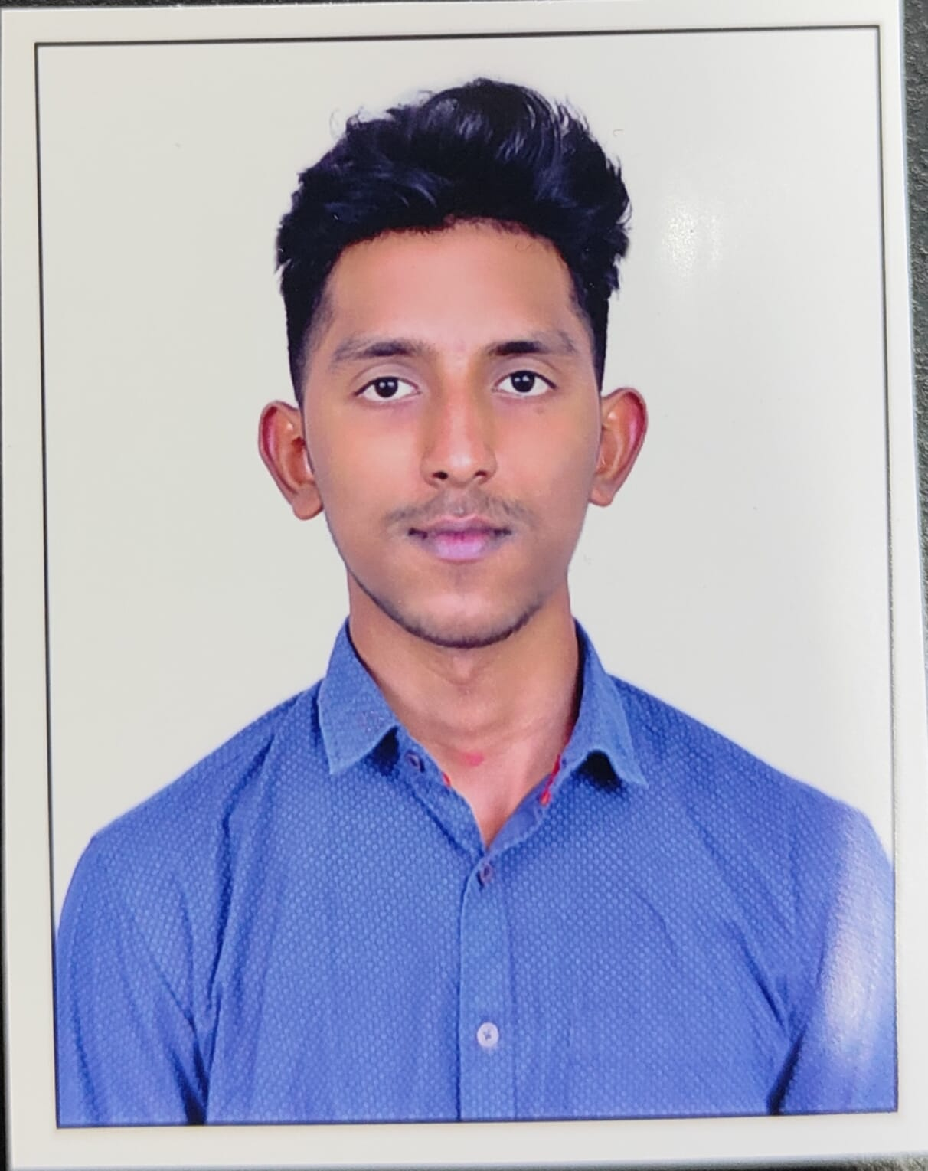
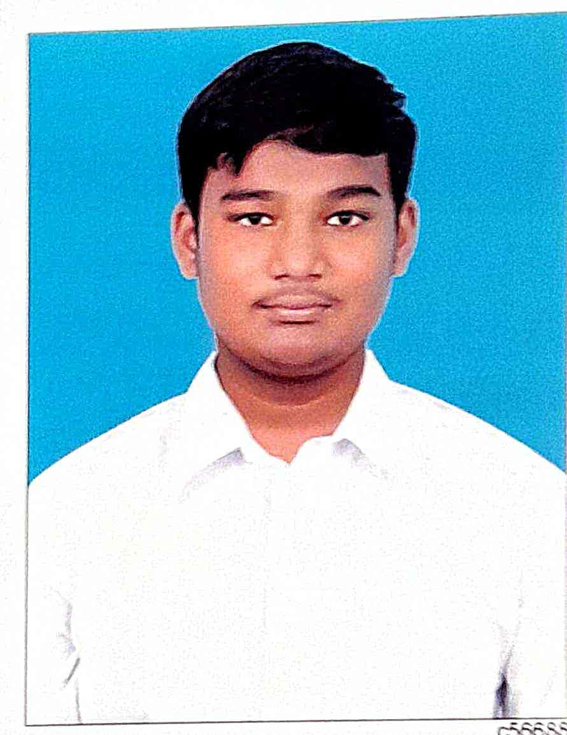
Slide 7
Team Members
"Showcasing your talent in an engaging, customizable digital space."
Slide 6
01
02
Slide 5
Slide 4
Vinith K V
Tarun Nayaka R
Slide 3
Backend , Logic , data base management, UX, Authentication
Java Script, PPT, CSS, SCSS, HTML, Jinjax, templating, URL navigation
Slide 2
Production, Deployment
Slide 1

Slide 13



Slide 7
3 key Learning From the Project
"Unleash your creativity with a dynamic, personalized portfolio."
Slide 6
Form Validation & User Authentication
frontend Design Integration
Error Handling & User Feedback
Slide 5
Slide 4
Slide 3
Experience integrating dynamic backend with appealing frontend design.
Handling errors and providing informative feedback for a smoother user experience.
Implement secure login systems and form validations.
Slide 2
Slide 1

Slide 14



Slide 7
Future Scope
"Crafting interactive showcases, inspiring a digital presence."
Slide 6
2024
2025
2027
Slide 5
1
2
3
Slide 4
Scaling
Freelance
Ecommerce
We can scale it to
Companies, include domain and hosting services
We Can free lance
It to individuals
We can build a market
Slide 3
Slide 2
Slide 1

Slide 15
Slide 7
Slide 6
Thanks for Listening with great patience
Slide 5
Slide 4
"Empower your portfolio with dynamic versatility and interactive design, making your professional journey both captivating and efficient."
Slide 3
Slide 2
Slide 1

Slide 16

Scan this!

